Slide 1
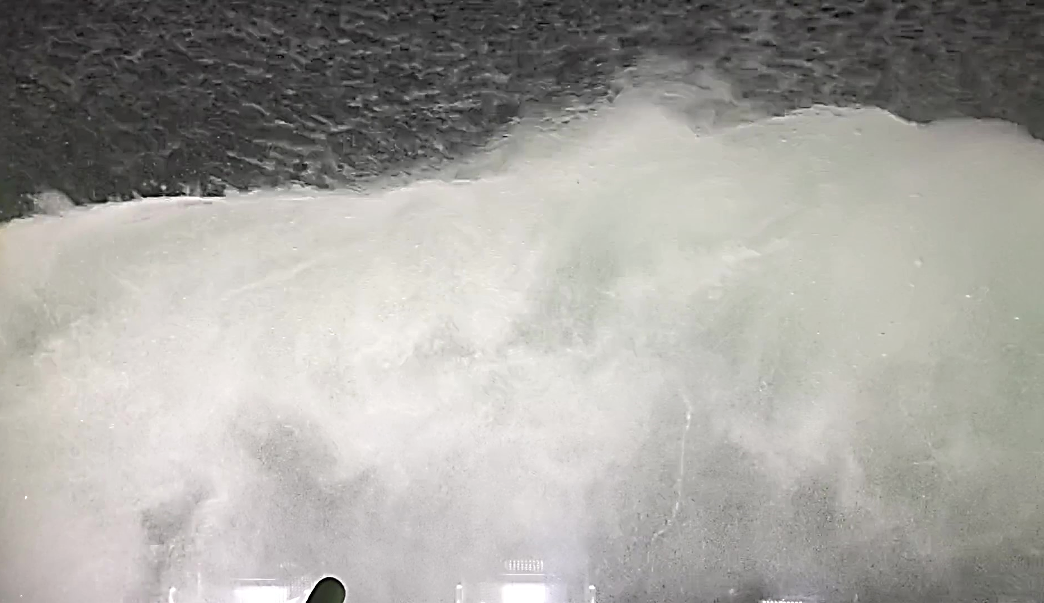


Investigating gas exchange processes using noble gases in very high winds: observations of bubbles and turbulence beneath breaking waves
Andrew W. Smith¹, Brian K. Haus¹ and Rachel H.R. Stanley^{2,3}
³ Wellesley College
¹University of Miami / RSMAS
² Woods Hole Oceanographic Institution
Postdoctoral Fellow Interview, April 19, 2024 | University of Rhode Island, Narragansett, RI

Slide 2
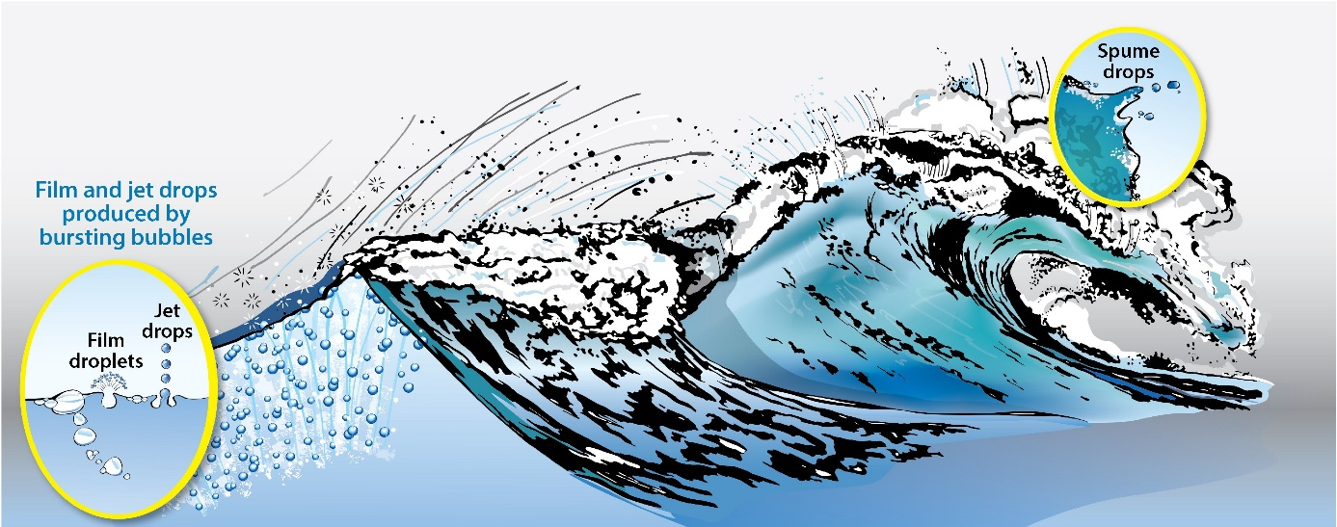
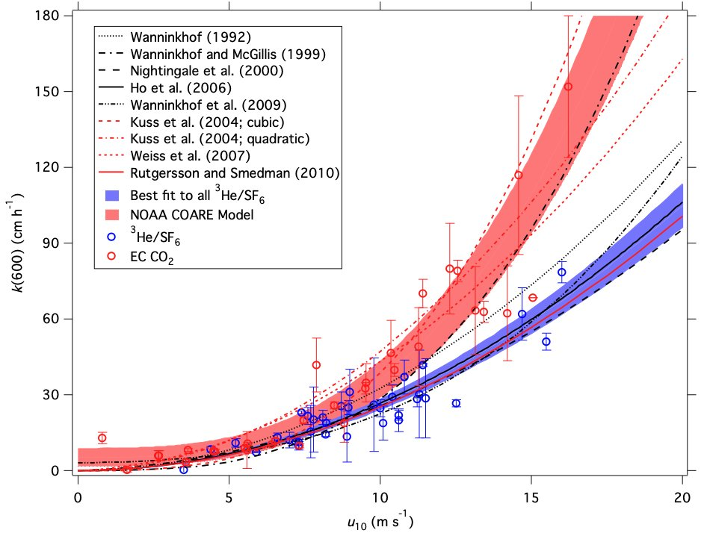
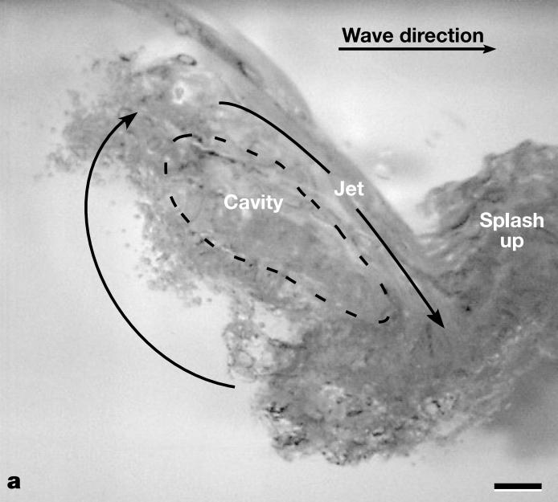
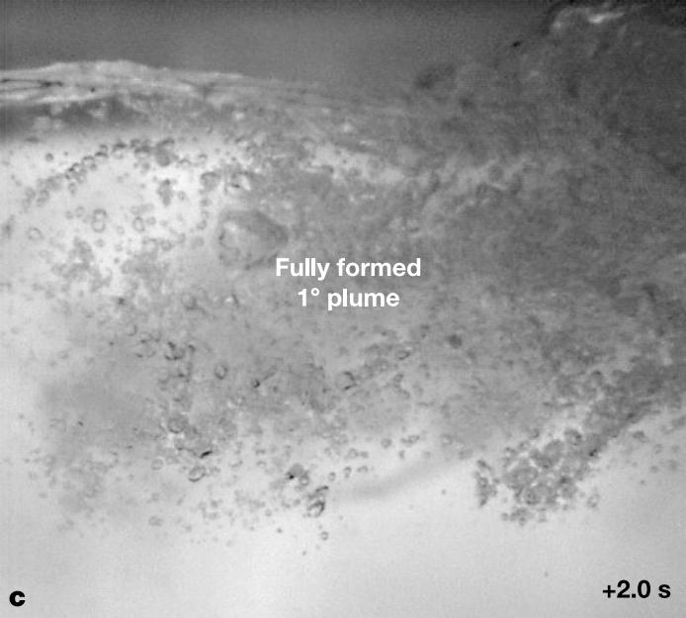
Breaking Waves, Gas Flux, and Uncertainty
Background and Motivation • Experiments and Facility • Results • Conclusions
Wave growth via wind-wave momentum flux culminates in physical destabilisation and breaking with varied intensity
Plunging, spilling breakers • Air entrainment, bubble plumes gas flux
Uncertainty in gas flux in higher winds, but inert tracers can help
Noble gases He, Ne, Ar, Kr, Xe
Up-scale ramifications for global climate change

Slide 3
Scientific Objectives
Background and Motivation • Experiments and Facility • Results • Conclusions
Conduct a series of laboratory experiments invading noble gases at different wind speeds, water temperatures, and wave conditions
1
Alfred C. Glassell, Jr. SUrge STructure Atmosphere INteraction (SUSTAIN) facility
Winds up to hurricane-force
Measure and observe surface waves, sub-surface bubbles, sub-surface turbulence dissipation
2
Connect breaking waves, bubble distributions, and gas flux
3
Monitor and sample individual noble gas concentrations and their ratios, assess behavior, role of wind, waves, solubility

Slide 4
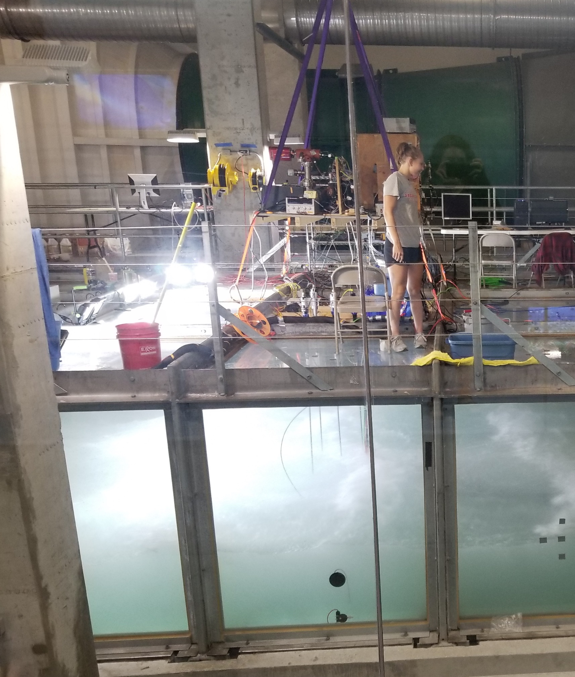
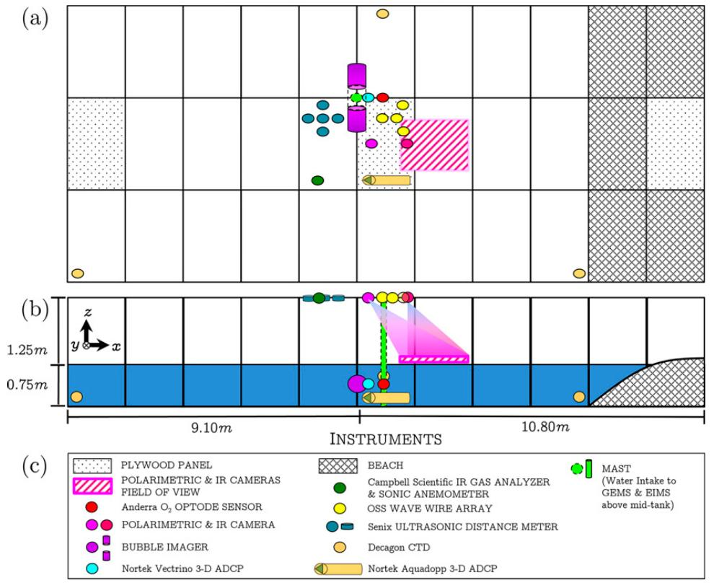
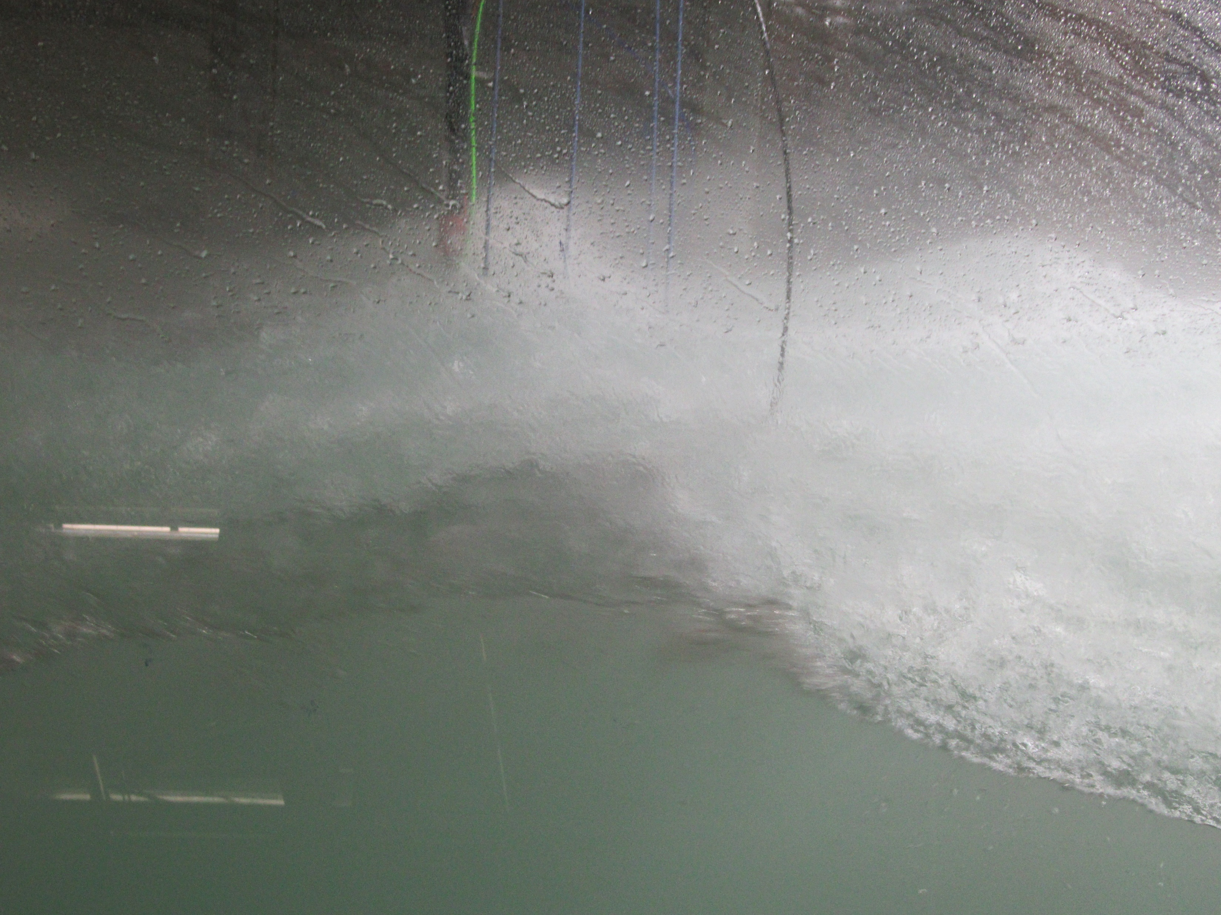
Laboratory Facility
Background and Motivation • Experiments and Facility • Results • Conclusions
SUrge STructure Atmosphere INteraction (SUSTAIN)

Slide 5
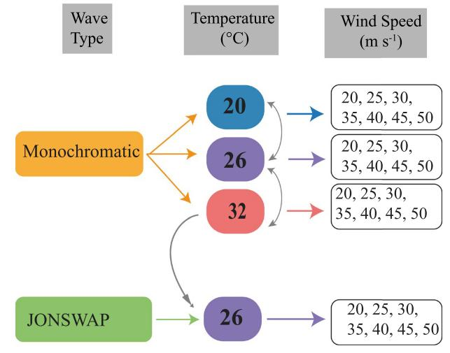
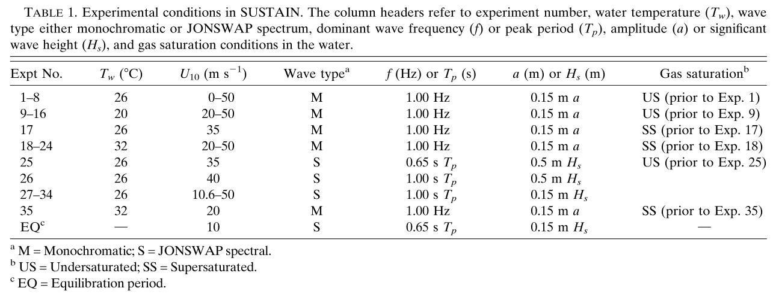
Experiments
Background and Motivation • Experiments and Facility • Results • Conclusions
35 experiments, July 10-15, 2018
Water temperature manipulated prior to some experiments to force super-saturation of noble gas (when warmed) or under-saturation of gas (when cooled)

Slide 6
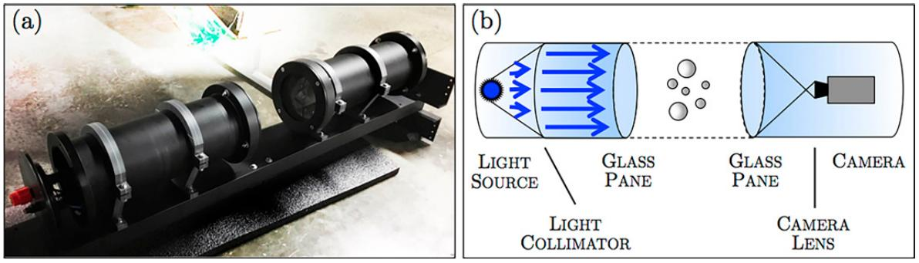
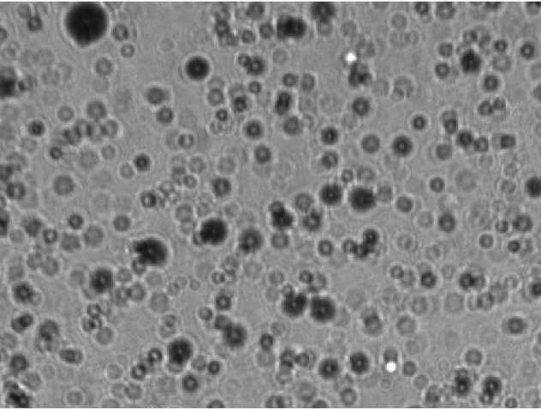
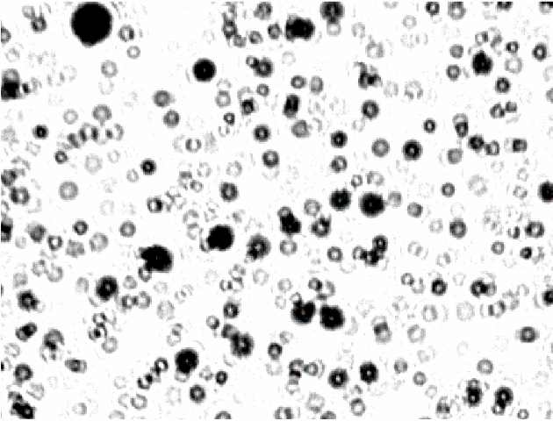
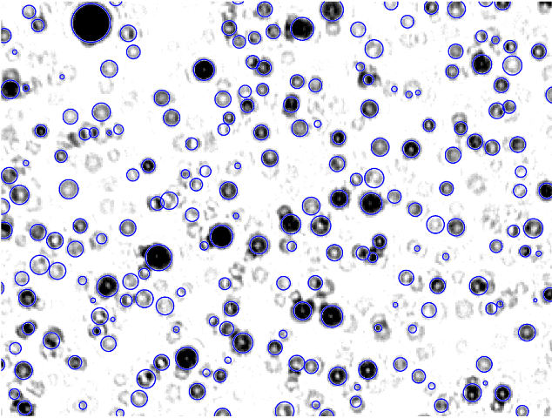
Experiments
Background and Motivation • Experiments and Facility • Results • Conclusions
SUSTAIN shadowgraph bubble imager
Circular Hough Transform (CHT)
Basler avA2300-gm area-scan camera
Kowa LM50HC F1.4/f = 50mm lens
Luxeon Rebel royal blue (470 nm) LED
Quiescent background removal
C-L adaptive histogram equalization
Perform CHT for bubble centers, edges, stats

Slide 7
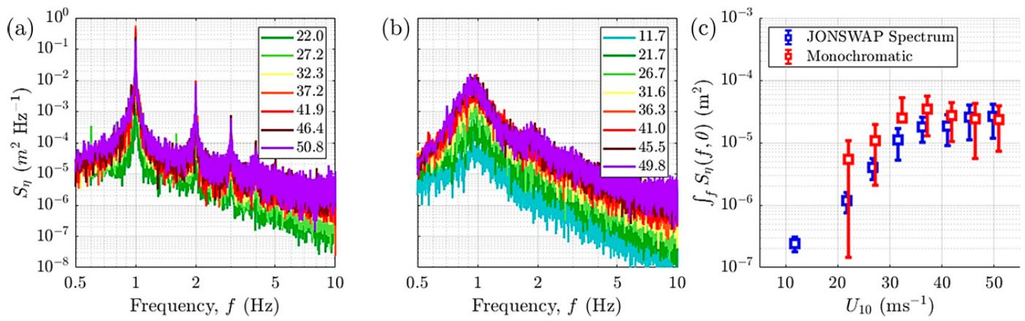
Results
Background and Motivation • Experiments and Facility • Results • Conclusions
Wave Spectra
Monochromatic
JONSWAP Spectrum
Water temperature 25.7C and 25.9C, filtered sea-water from Biscayne Bay
Average peak frequency 0.99 and 0.96 Hz, respectively
Integrated wave spectral density: increases with U_{10N} until about 37 ms⁻¹
At higher winds, monochromatic level-off, JONSWAP spectrum approaches

Slide 8
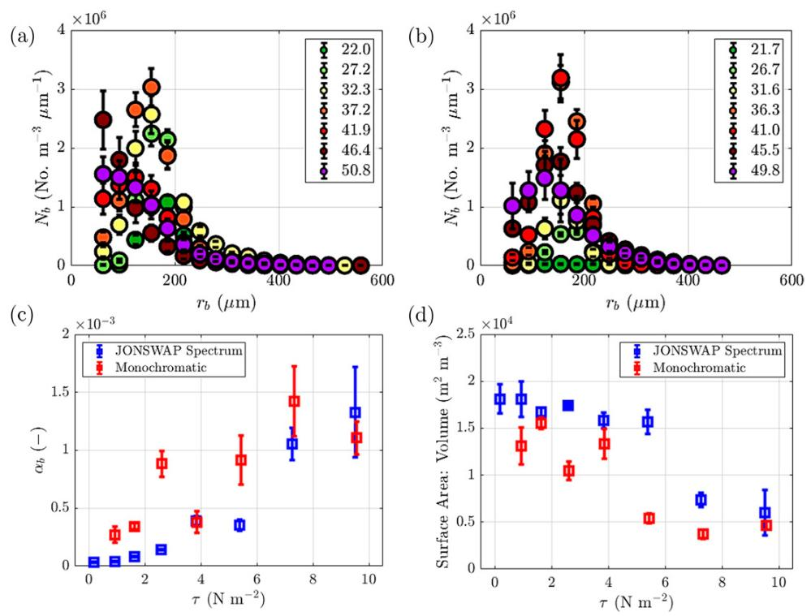
Results
Background and Motivation • Experiments and Facility • Results • Conclusions
Bubble Spectra
Monochromatic
JONSWAP Spectrum
Average bubble size distributions increase over low - moderate (U_{10N} < 37 ms⁻¹)
Number of bubbles increases more rapidly beneath monochromatic vs JONSWAP spectrum, both decrease at higher winds
Bubble size decreases 8% faster with 1.7x greater bubble radius variance beneath monochromatic waves (23% steeper, 13% more asymmetric, 40% larger breaking intensity)

Slide 9
Results
Background and Motivation • Experiments and Facility • Results • Conclusions
Void Fraction and Surface Area to Volume Ratio
Monochromatic
JONSWAP Spectrum
Void fraction 3.2x larger on average in monochromatic waves vs JONSWAP
Void fraction increases 1.5x faster per unit stress in JONSWAP though
SA:V 1.6x larger in JONSWAP, but SA:V decreases 4.7x faster in monochromatic
Larger void fractions and more rapidly decreasing SA:V with increasing stress in steeper monochromatic waves vs. JONSWAP spectrum

Slide 10
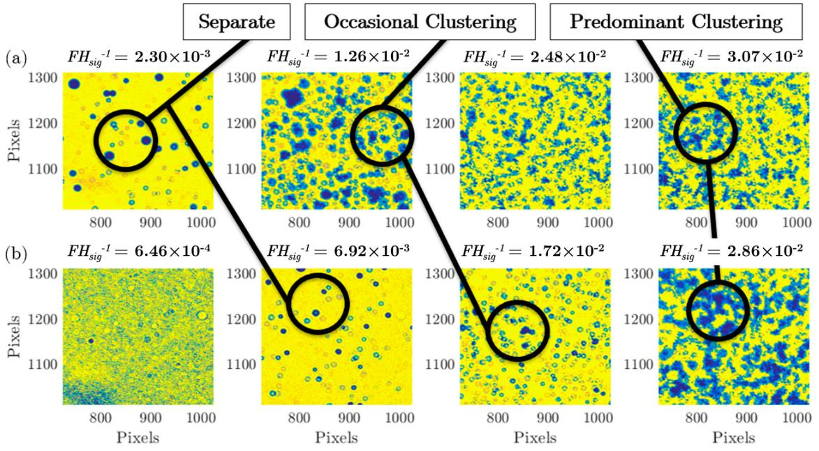
Results
Background and Motivation • Experiments and Facility • Results • Conclusions
Sub-Surface Bubble Evolution
Monochromatic
JONSWAP Spectrum
Circular Hough Transform used in bubble center and edge detection
Larger wave-scaled wind-wave energy input (wave-induced turbulence) in monochromatic waves vs. JONSWAP
Separate bubbles transition to more clustered behavior in images, accuracy challenged in high winds

Slide 11
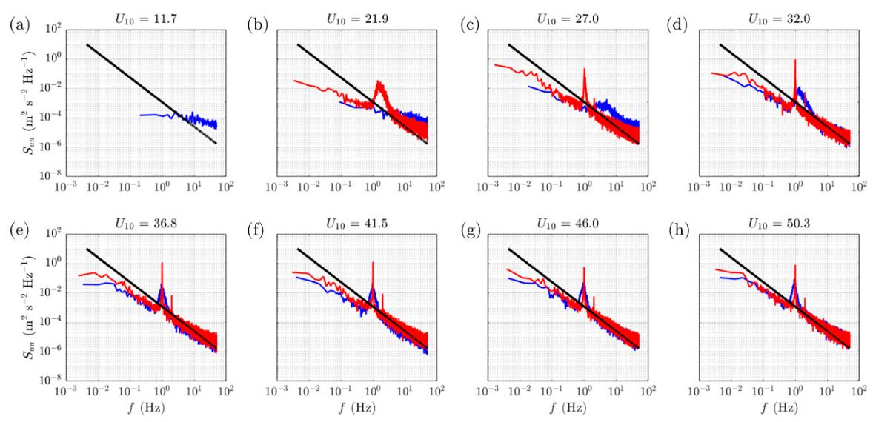
Results
Background and Motivation • Experiments and Facility • Results • Conclusions
Sub-Surface TKE & Dissipation
Monochromatic
JONSWAP Spectrum
TKE dissipation rate determined from sub-surface ADCP velocity spectra
Dissipation rates larger (4.7 x 10⁻³ – 1.3 x 10⁻² m² s⁻³) in monochromatic vs JONSWAP (2.7 x 10⁻³ – 1.2 x 10⁻² m² s⁻³); higher ADCP SNR

Slide 12
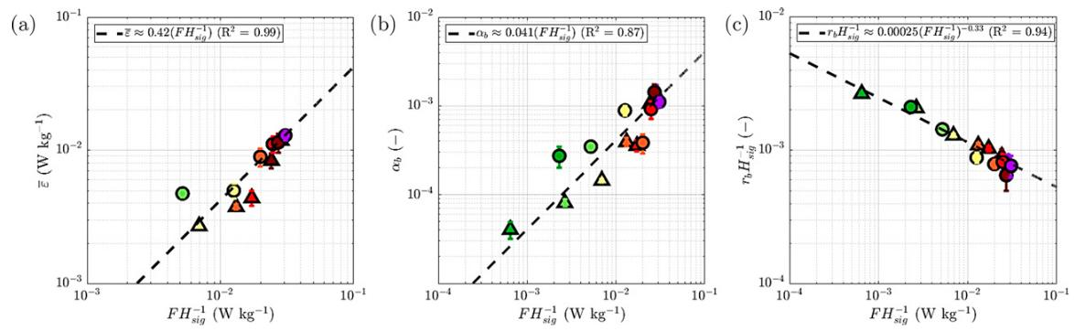
Results
Background and Motivation • Experiments and Facility • Results • Conclusions
Sub-Surface TKE & Dissipation
Monochromatic (circles)
JONSWAP Spectrum (triangles)
Dissipation rates increase with wave-scaled wind-wave energy input, which accounts for wind-wave alignment, wind speed, phase speed of waves
Void fraction increases with wave-scaled wind-wave input
Wave-scaled bubble radius decreases with wave-scaled wind-wave energy input

Slide 13
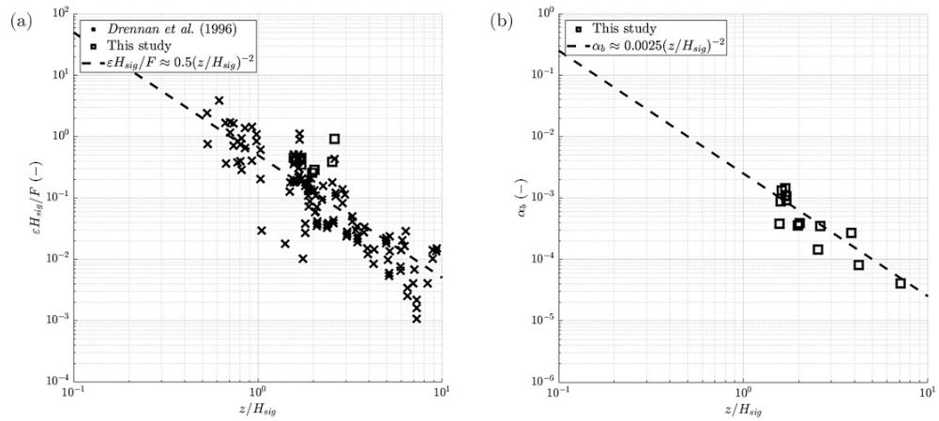
Results
Background and Motivation • Experiments and Facility • Results • Conclusions
Sub-Surface TKE & Dissipation
Wind-wave input-scaled dissipation rate increases as significant wave height increases and/or proximity to the wavy surface increases
Void fraction increases as well
Laboratory findings lie amongst field data from SWADE and WAVES field campaigns where measured

Slide 14
Conclusions
Background and Motivation • Experiments and Facility • Results • Conclusions
Smith, Haus, and Stanley (2022)
Increasing wind stress and wave height result in greater volume of air entrainment, greater number of bubbles
1
Air entrainment greater, but bubble size smaller as wave-scaled wind-wave energy input increases
2
3
Sub-surface turbulence and dissipation larger beneath monochromatic vs JONSWAP spectrum waves
4
Wave-scaled dissipation rates agree with power-law fit scaling and observations in SWADE and WAVES campaigns
Stanley, Kinjo, Smith, et al. (2022)
5
Steady-state gas saturation anomalies and noble gas fluxes increased initially and then leveled off at high winds
6
Significant wave height and wave steepness better predict gas fluxes than wind speed, especially in JONSWAP spectrum waves that approximate real open ocean conditions
7
Important differences in gas flux when considering invasion vs. evasion for all noble gases, need to account for this in future parameterisations

Slide 15
References
Background and Motivation • Experiments and Facility • Results • Conclusions
Smith, A. W., Haus, B. K., & Stanley, R. H. R. (2022). Bubble-turbulence dynamics and dissipation beneath laboratory breaking waves. Journal of Physical Oceanography, 1, 2159–2181. https://doi.org/10.1175/JPO-D-21-0209.1
Stanley, R. H. R., Kinjo, L., Smith, A. W., Aldrett, D., Alt, H., Kopp, E., Krevanko, C., Cahill, K., & Haus, B. K. (2022). Gas Fluxes and Steady State Saturation Anomalies at Very High Wind Speeds. Journal of Geophysical Research: Oceans, 1–19. https://doi.org/10.1029/2021jc018387

